Slide 1
A Deep Dive Into How Inflation And National Income Impacts Singapore’s Computing Graduates
CA2
PDAS CA2 - DAAA/FT/1B/07
Done By: Balamurugan Siddhartha (P2404312) & Lo Jia Wei (P2400277)

Slide 2
Our Presentation Flow
01
Background Information & Research
02
EDA (Using Pandas, NumPy, MatPlotLib, seaborn & StatsModels)
03
Statsmodels Statistical Modelling & Analysis
04
Matplotlib Visualisations & Insights
05
Conclusions to our research question!

Slide 3

Research Question
How do inflation rates and national gross monthly income influence the employment rates and salaries of Computing Graduates in Singapore from 2013 to 2023?

Slide 4
Datasets Analysis
Before starting the assignment, We skimmed through the provided datasets to get a better understanding of the data quality, including the extent of missing values and the range of variability in the data. We also inspected the columns to gain better clarity. To ensure accurate results for our research question, we aimed to identify potential trends and get an overall sense of the number and structure of the columns!
Datasets Used | Brief Understanding
graduate_employment_survey.csv (Taken From Brightspace) | Contains graduate employment data, including universities, degree programmes, employment rates, and salaries from 2013 to 2022. Requires data cleaning for missing values! Seems like we need to predict for the year 2023 using statsmodel Ordinary Least Squares (OLS) regression!
national_gross_monthly_income_MOM.xlsx (MOM (Ministry Of Manpower) Table: Employment 2023 Section C) | Contains national gross monthly income data from MOM, including median and mean salaries across different years. Requires cleaning for missing values and adjustments for inflation analysis.
worldbank_inflation_data.csv World Bank Inflation Rates Dataset (2013-2023) | Contains global inflation data from the World Bank, including annual inflation rates by country. Requires filtering for relevant years and countries, and handling of missing values for analysis.

Slide 5
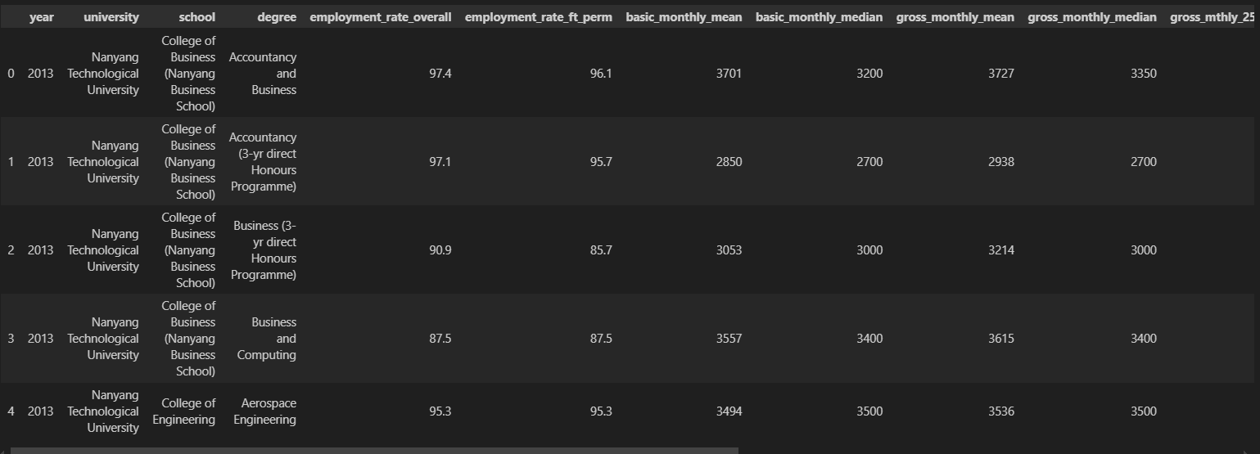
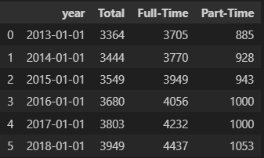
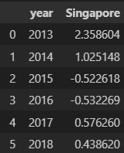
Background Information
Graduate Employment Survey
This assignment involved analysing datasets that includes the University Graduate Employment Survey, National Gross Monthly Income Median, and National Inflation Rates from 2013 to 2023. The goal is to uncover meaningful patterns and trends in the job market by examining graduate employment outcomes alongside national salary trends and inflation rates over the years.
National Gross Monthly Income Dataset From Ministry Of Manpower (MOM)
For this analysis, we used Pandas for data handling, NumPy for calculations, and Matplotlib for visualisation. We also applied StatsModels for statistical modelling to study the relationship between economic factors and graduate employment outcomes!
Our study examines how national salary trends and inflation rates from 2013 to 2023 have influenced employment rates for computing graduates. Using data from the University Graduate Employment Survey, National Gross Monthly Income Median, and National Inflation Rates, we identified key patterns in employment and salary trends.
We also built statistical models to predict the 2023 graduate employment rate and gross monthly median income, considering the impact of inflation and national income trends. This helped us understand how economic changes affect graduate job prospects and salaries.
Worldbank Inflation Rate Dataset (After filtering to Singapore)

Slide 6



Exploratory Data Analysis & Data Wrangling (Using Pandas, Numpy & Statsmodels)
Let’s Dive In & Analyse The Dataset!

Slide 7


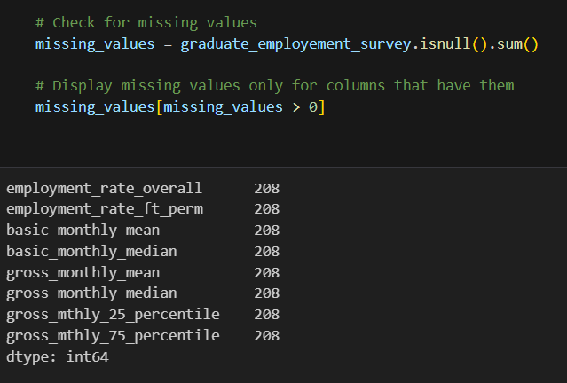
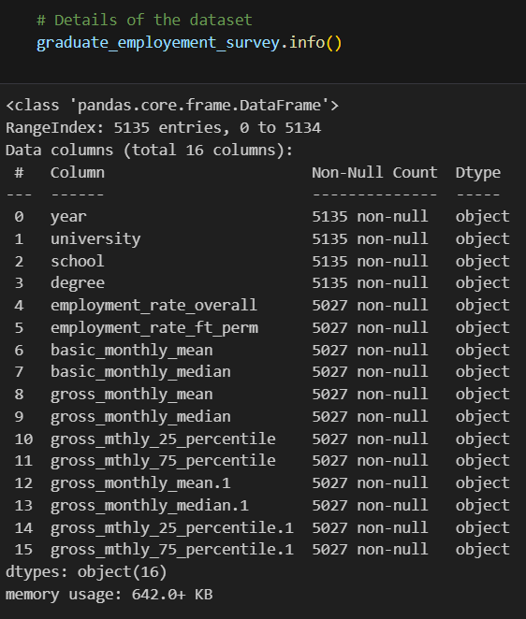
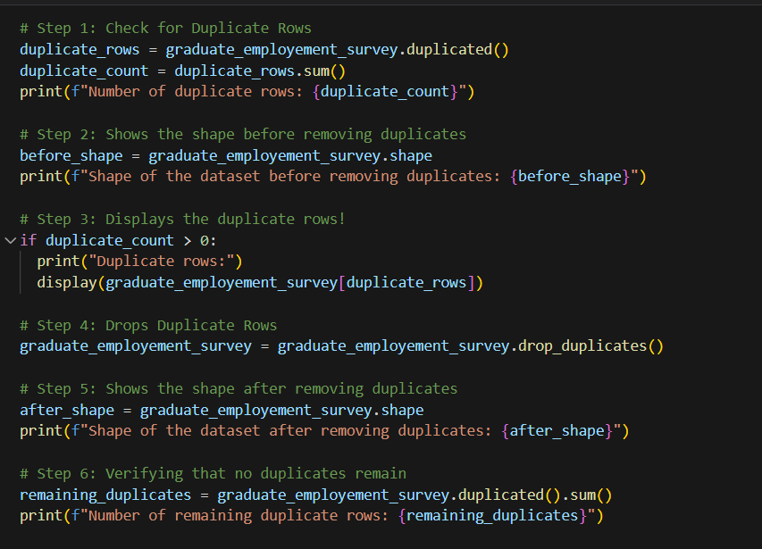
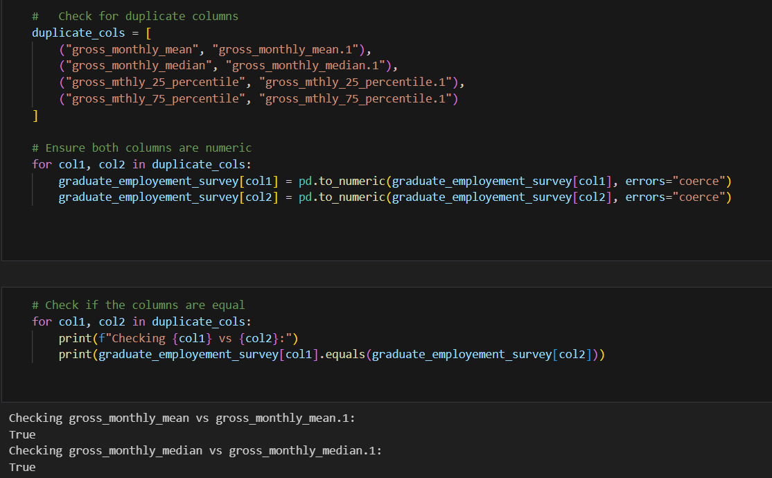
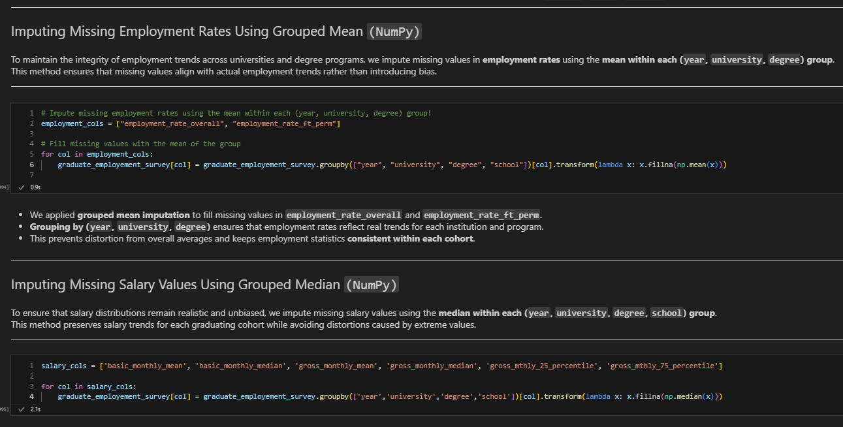
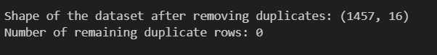

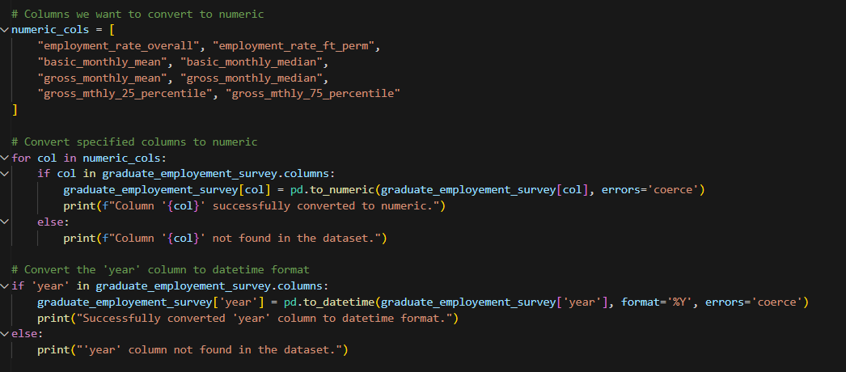
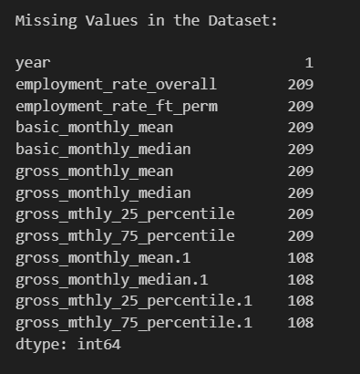
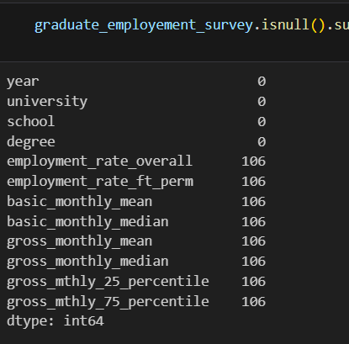
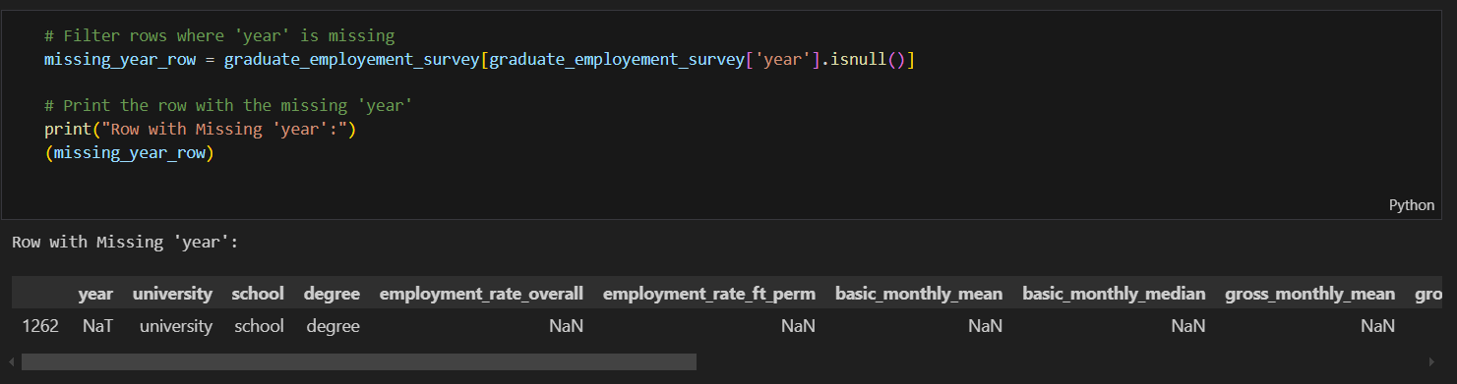
Dataset 1: Data Exploration & In-Depth Analysis
`.info` on dataset
Checking duplicate rows & handling it!
Checking Duplicate Columns & Dropping Them
We identified 208 missing values in key employment and salary columns. This required imputation to maintain data consistency.
Then, We Imputed using NumPy (Group-By Mean & Median)!
In this, we grouped by year, university, degree & school and made use of
NumPy to impute!
We identified and removed 3,678 duplicate rows from the dataset, reducing its size from 5,135 to 1,457 rows. This ensured data quality by eliminating redundancy.
We checked for duplicate columns and found that gross_monthly_mean and gross_monthly_median had identical duplicate versions. After confirming their values were the same, we removed the redundant columns to maintain dataset clarity.
Converting numeric columns to appropriate numeric format and transform the year column to datetime.
Investigating the funny year in our dataset!
We identified row 1262 with a missing year value through our detailed data analysis.
It contained placeholder entries in key columns (university, school, degree).
Salary and employment rate fields had NaN values, making the row unusable for analysis.
Decision: ✅ We removed the row to maintain data quality, accuracy, and consistency in our analysis.
Investigating this funny year in our dataset

Slide 8
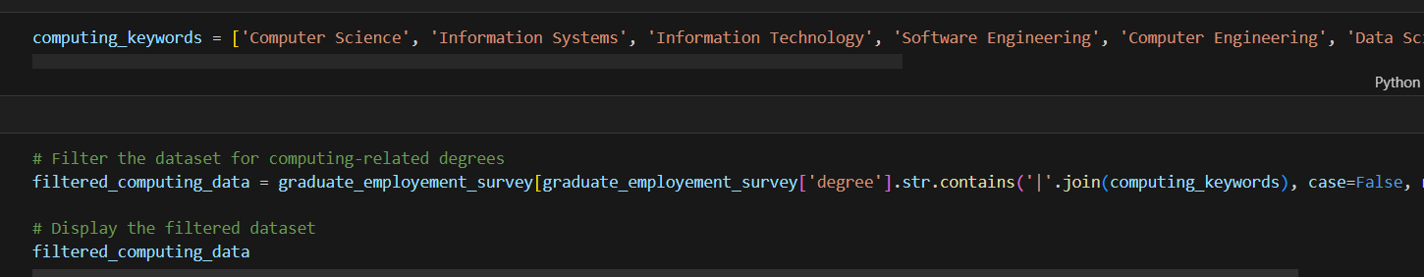
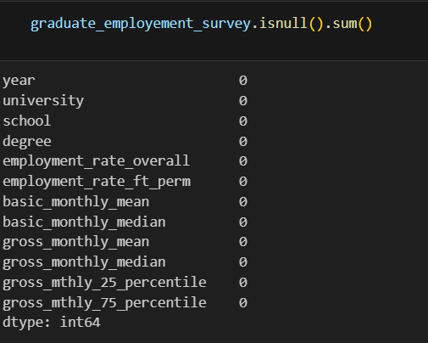

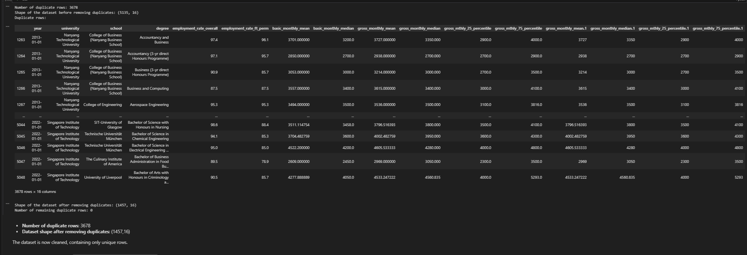
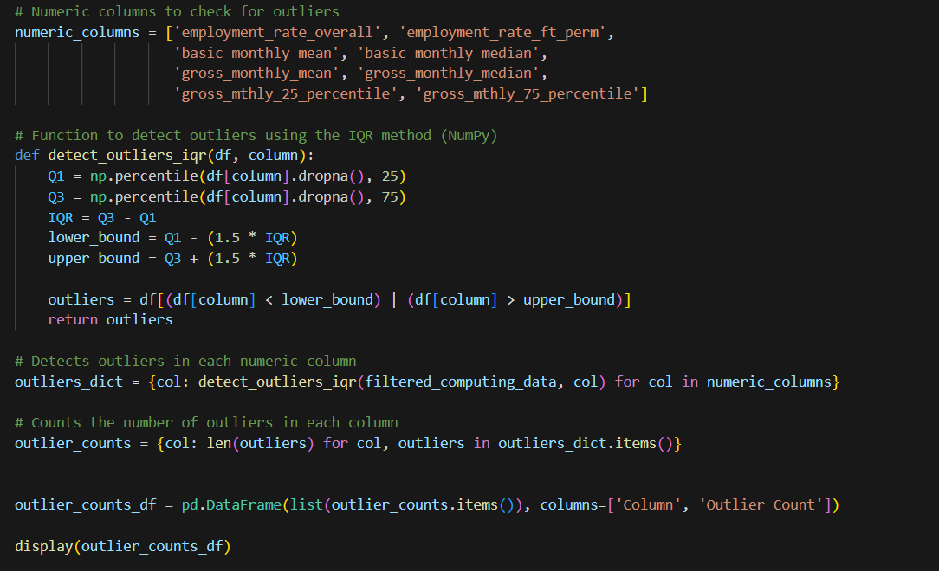
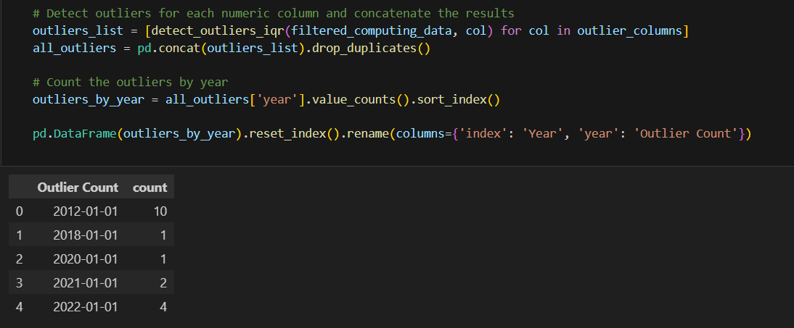
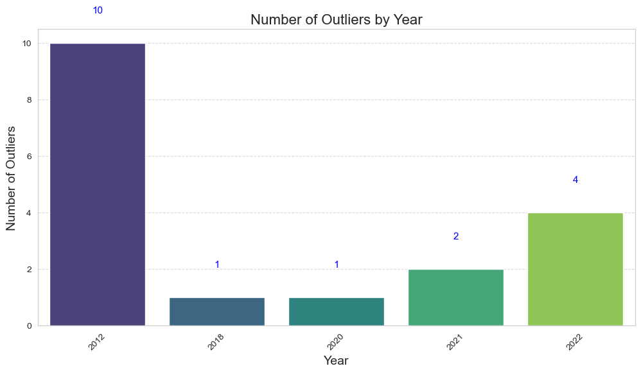
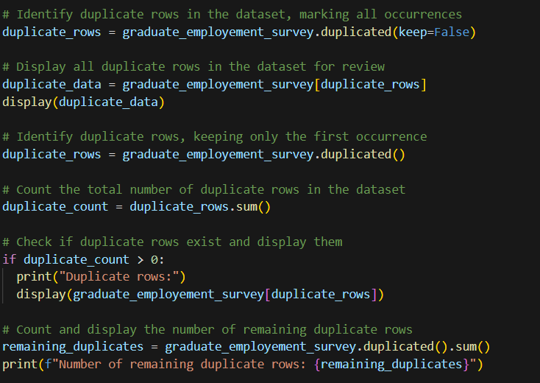
Dataset 1: Data Exploration & Cleaning (Preprocessing)
Handling Additional Missing Data
Using Regex Matching To Filter Computing Related Data For Our Research Question!
We dropped rows with missing values because key categorical columns such as year, university, degree, and school are essential for grouping and analysis. Since missing values prevent accurate aggregation and comparisons, and there were no reliable ways to impute them, removing these rows was the only viable option to maintain data integrity and ensure meaningful insights.
We applied regex matching to filter the dataset for computing-related degrees, ensuring that our analysis remains focused on relevant fields like Computer Science, Information Systems, and Software Engineering. This step is crucial in directly linking our findings to the research question, which examines the employment rates and salaries of Computing Graduates in Singapore.
Handling Outliers
Outliers Detected!!
Investigating 2012 as a Major Outlier
After handling outliers, we identified 2012 as a significant anomaly with 10 extreme data points, far exceeding other years.
Since 2012 is just a duplicate of 2013, with key numerical features like basic and gross monthly salaries divided by 10, it introduces an error in the dataset. Because of this inconsistency, we excluded 2012 from our analysis to maintain data accuracy and ensure the reliability of our findings!
Handling Duplicate Rows
After completing preprocessing steps like imputations, we performed a quick check for duplicates. A total of 3,678 duplicate rows were found and removed, reducing the dataset size and ensuring data integrity.

Slide 9


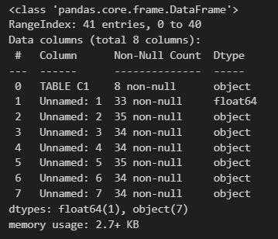
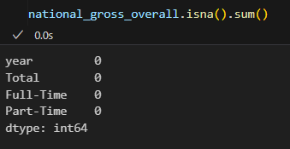
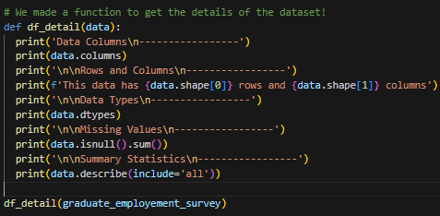
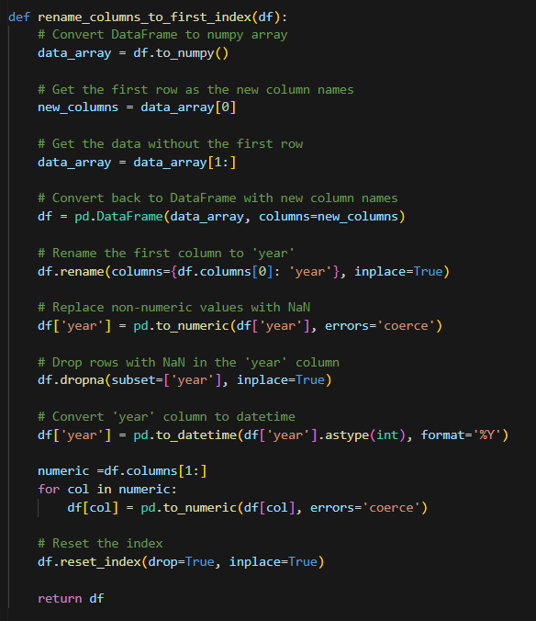
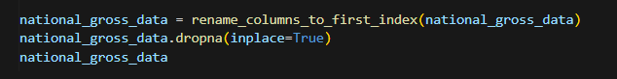

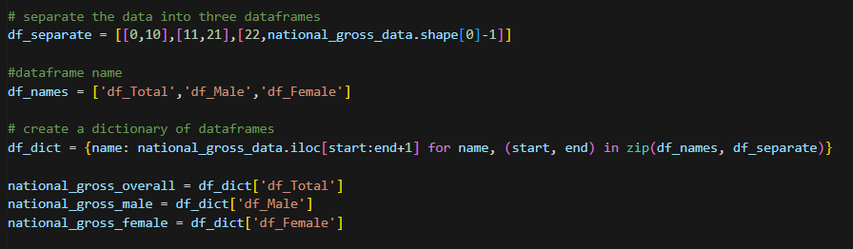
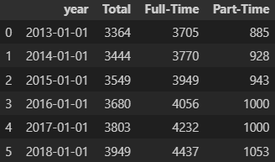
Dataset 2: Data Exploration & Cleaning (Preprocessing)
.info() on MOM Dataset (Gross Monthly Income)
Check for missing values !
Function to rename columns, convert the year column to datetime format, and transform all numeric columns to int64 using NumPy and Pandas."
We used “df_detail” for efficient EDA
Since this data comes from the official MOM source, our check for missing values confirmed that there were none.
We used df_detail to provide a concise summary of the dataset, including its structure, data types, missing values, and key statistical insights. This helps in understanding the dataset’s composition, identifying potential issues, and making informed preprocessing decisions before analysis.
The .info() method provided a quick and efficient way to understand the structure and quality of the datasets. It revealed essential details such as the number of columns, non-null counts, data types, and memory usage for each dataset.
We split the dataset from MOM into three separate datasets: national_gross_overall, national_gross_male, and national_gross_female.
Final Data After Preprocessing → National Gross Overall Data

Slide 10
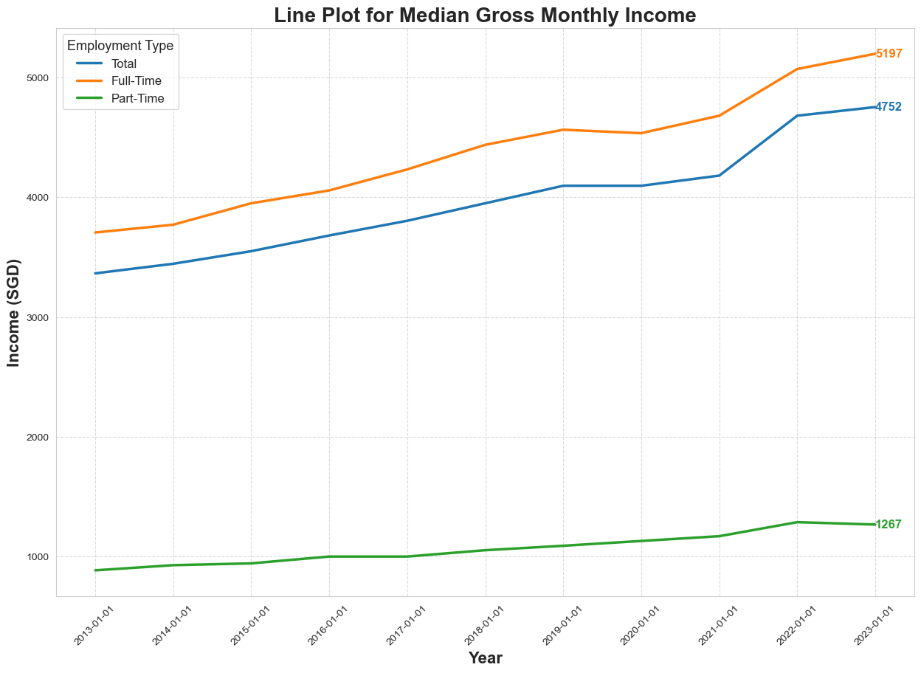
Dataset 2: Visualising National Median Gross Monthly Income Trends (2013-2023)
From 2013 to 2023, all employment categories experienced an upward trend in income, with Full-Time workers consistently earning the highest salaries, followed by Total employment and Part-Time workers. The growth rate varied across different periods, reflecting economic shifts, external factors such as the COVID-19 pandemic, and overall wage progression.
Key Insights
2013-2014: Income gradually increased across all employment types, with Full-Time maintaining a clear lead.
2014-2016: Steady growth in Full-Time and Total employment, while Part-Time saw minor improvements.
2016-2018: Full-Time wages grew faster, widening the gap, while Part-Time income stagnated.
2018-2020: Moderate growth continued until 2020, when the pandemic slowed salary increases.
2020-2021 (COVID-19): Wages stagnated, with companies freezing salaries; Part-Time workers remained the most vulnerable.
2021-2022: Strong post-pandemic recovery, with rising wages across all categories
2022-2023: Full-Time income hit SGD 5,197, Total reached SGD 4,752, but Part-Time lagged at SGD 1,267, widening the income gap.

Slide 11

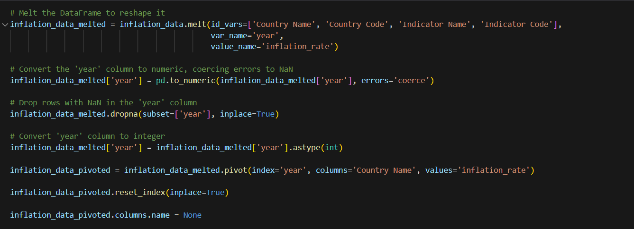
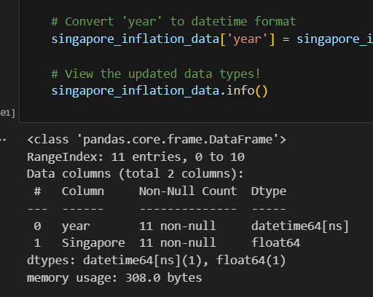
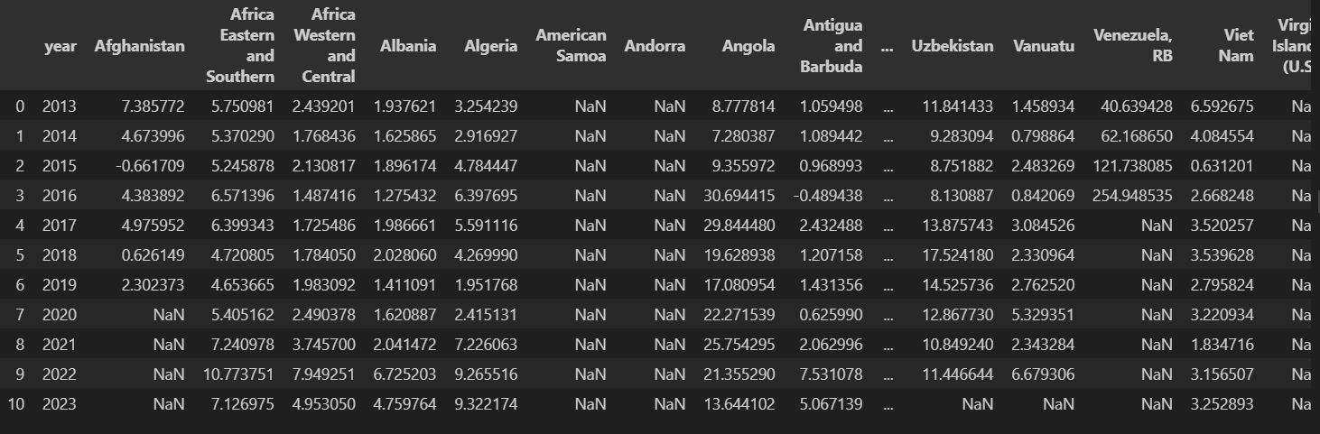

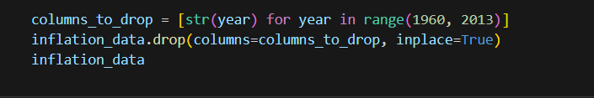
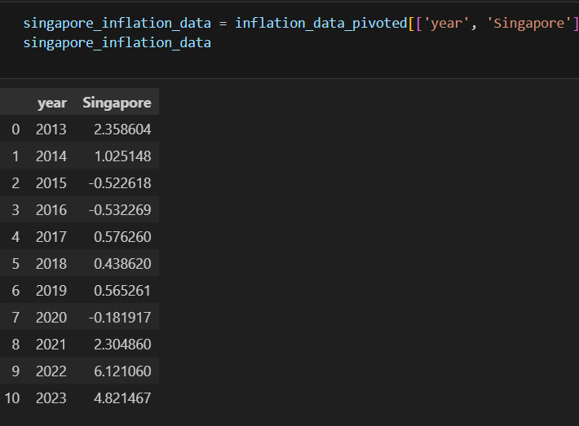
Dataset 3 : Exploratory Data Analysis Using NumPy & Pandas
.info() on each dataset
Reshaping the Dataset for Easier Merging
Converted years from columns to rows, making the dataset more structured.
Pivoted the data, setting year as the index and country as columns for better organization.
Reset the index to move year back as a column, ensuring compatibility for merging.
This transformation simplifies merging with other datasets using the year column as a common key.
Insights from .info()
Dataset contains 11 rows and 2 columns.
year column successfully converted to datetime64 format.
No missing values detected in either column.
Inflation data stored as float64, ensuring numerical operations can be performed smoothly.
Memory usage is minimal (308.0 bytes), indicating a lightweight dataset.
We filtered the dataset to retain only data for Singapore, removing all other countries to match our research question!
Filtering Dataset 3 for Relevant Years
We removed data from 1960 to 2012 to focus only on 2013 to 2023, aligning with our research question.
This ensured that only relevant inflation data was used to analyse its impact on salaries and employment rates.
By filtering the dataset, we improved data consistency and focused on recent economic trends.

Slide 12
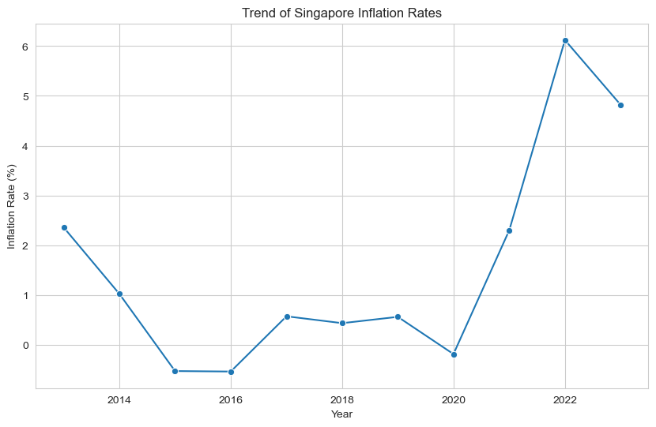
Dataset 3: Visualising The Trends of Singapore's Inflation Rates (2013-2023)
This line chart visualizes the inflation rate trend in Singapore over multiple years, capturing fluctuations from 2013 to 2023. The x-axis represents the years, while the y-axis represents the inflation rate (%). Data points are marked with dots, and a line connects them to show the trend.
Key Insights
2013-2015: Inflation declined from 2.5% to near 0%, indicating slowing price growth.
2015-2020: Inflation remained low and stable (0% - 1%), with a dip during COVID-19 (2020).
2021-2022: A sharp spike from 2.5% to over 6%, driven by post-pandemic recovery and supply chain issues.
2023: Inflation dropped slightly but stayed above 4%, signaling persistent economic pressures.
Possible Causes of Inflation Trends
2013-2015: Declining inflation due to economic slowdowns and policy interventions.
2015-2020: Low and stable inflation, reflecting a balanced economy with controlled price increases.
2021-2022: Post-pandemic inflation surge, driven by supply chain issues, economic reopening, and rising energy costs.
2023: Inflation remains high but shows signs of moderation, possibly due to government policies, interest rate hikes, and economic adjustments.

Slide 13
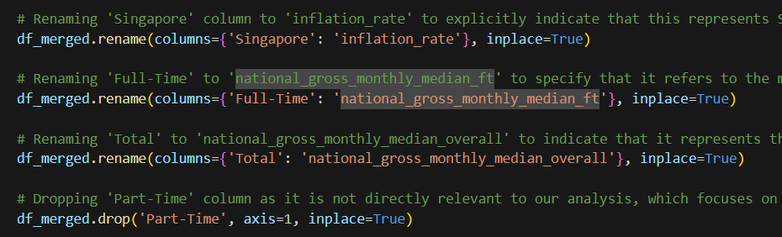
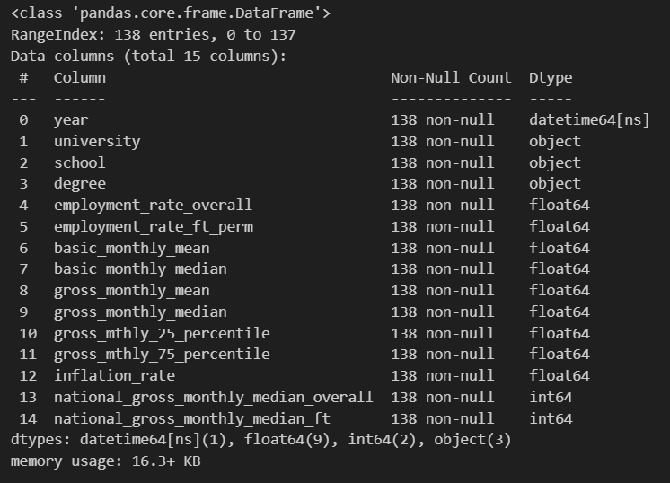
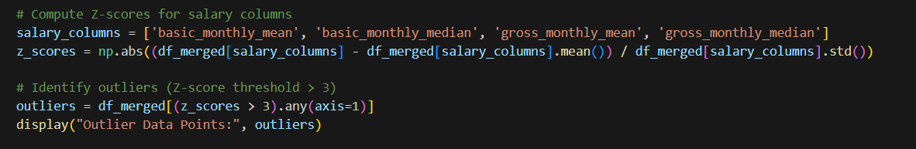
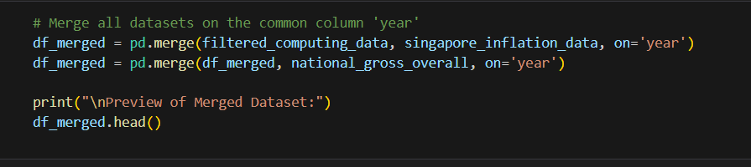
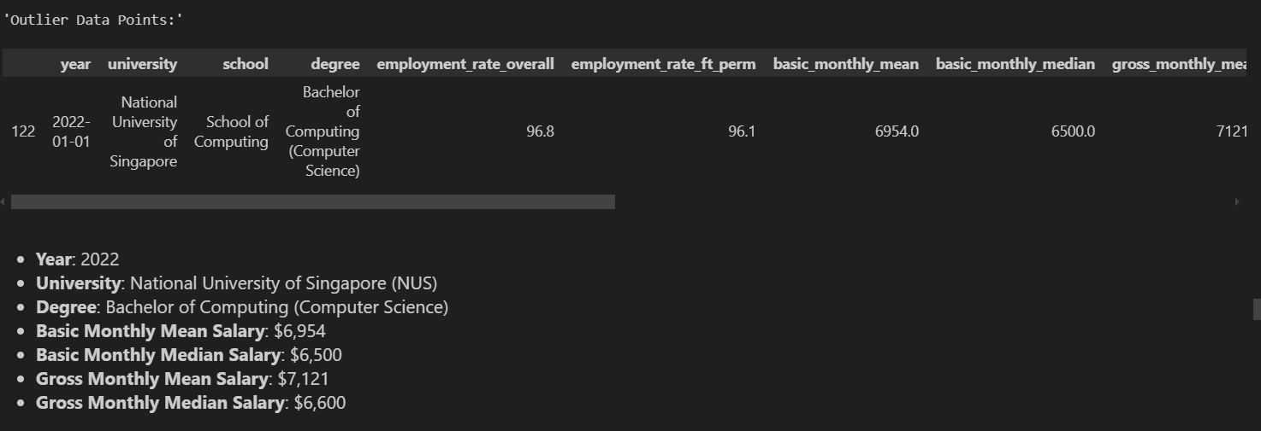
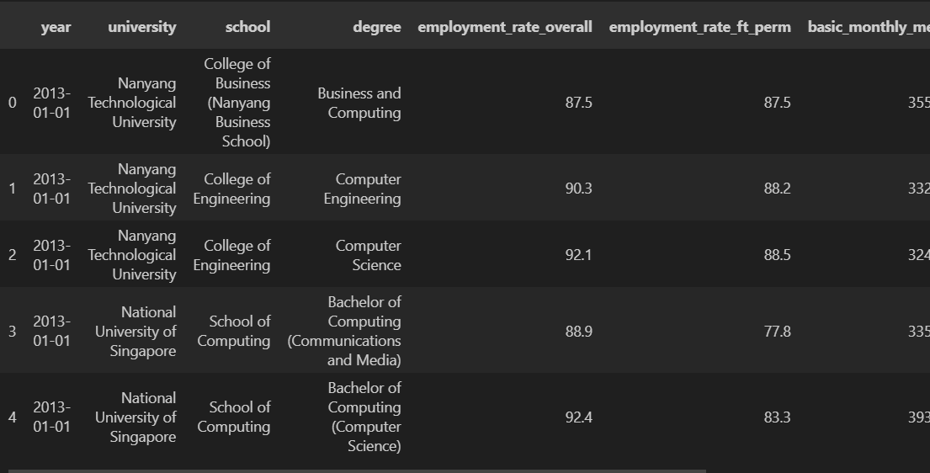
Merged Data: Merging Datasets For Efficient EDA
We renamed columns to more specific and meaningful names to improve clarity and understanding
.info() of merged dataset
Z-scores computed for key salary columns to standardise values.
Outliers identified where Z-score > 3, indicating extreme salary variations.
Outliers may represent exceptional high/low salaries due to market demand, industry specialization, or data inconsistencies.
Ensures robust analysis by detecting anomalies that could skew salary trends.
Insights from .info()
Dataset contains 138 rows and 15 columns.
Year column successfully converted to datetime64 format.
No missing values detected across all columns.
Salary and employment data stored as float64, ensuring smooth numerical operations.
Memory usage is 16.3 KB, indicating a manageable dataset size.
Datasets merged successfully on the common column 'year'.
Combines computing employment & salary data, inflation data, and national income trends into a unified dataset.
Ensures a consistent time-series analysis across all relevant economic and employment factors.
df_merged.head() preview confirms successful integration of datasets, enabling further analysis.

Slide 14
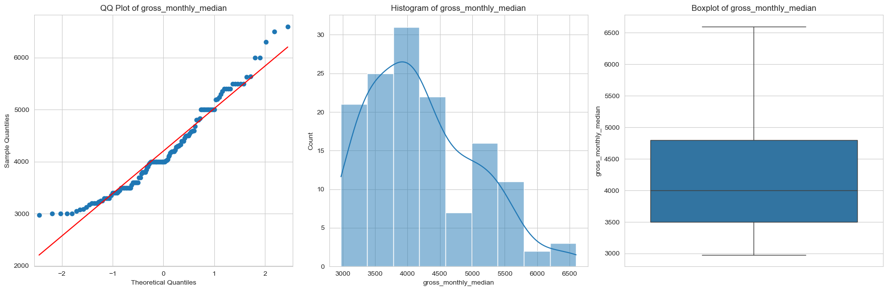
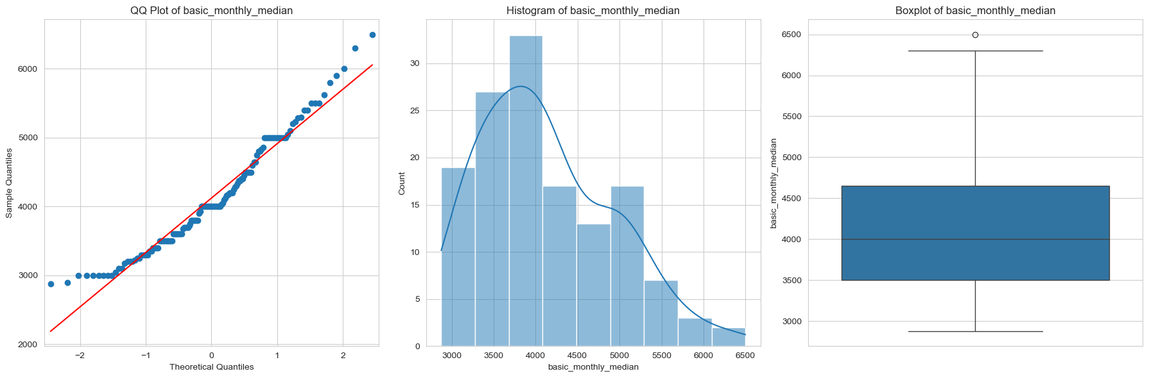
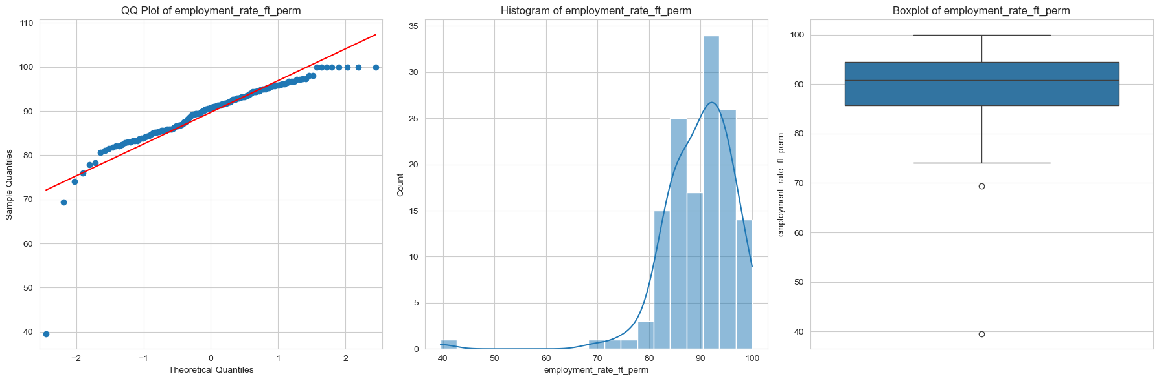
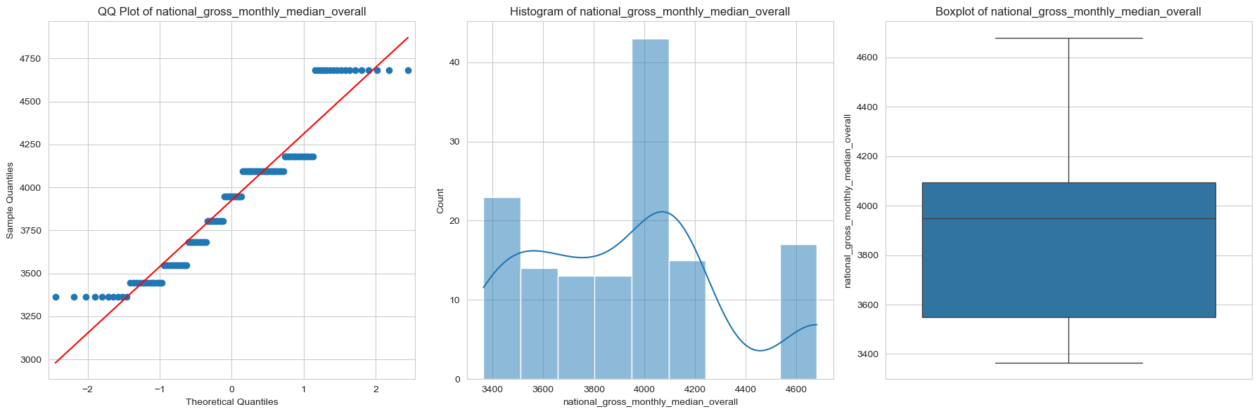
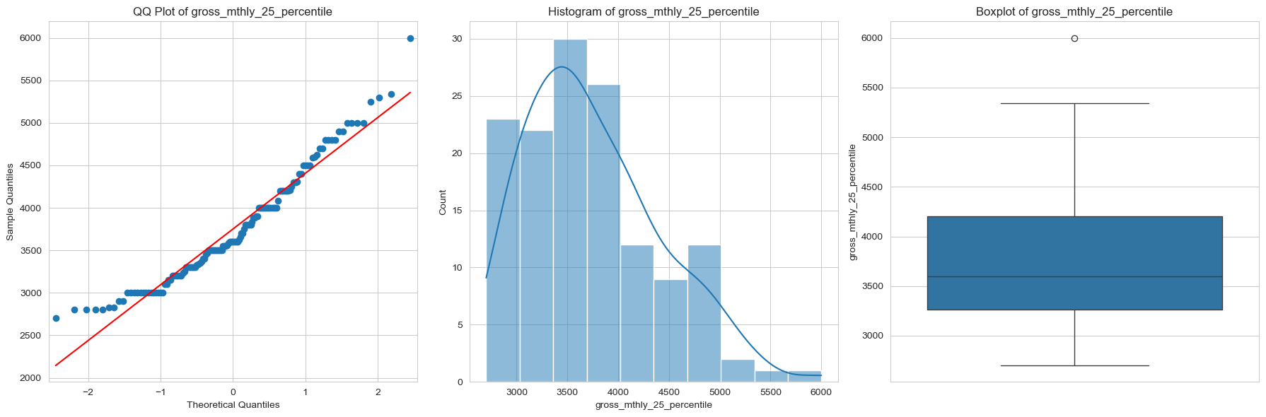
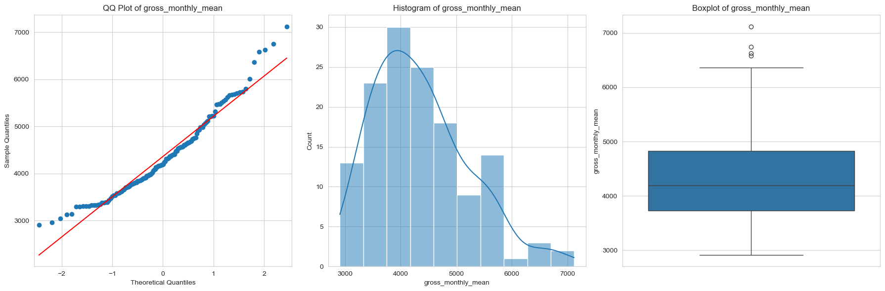
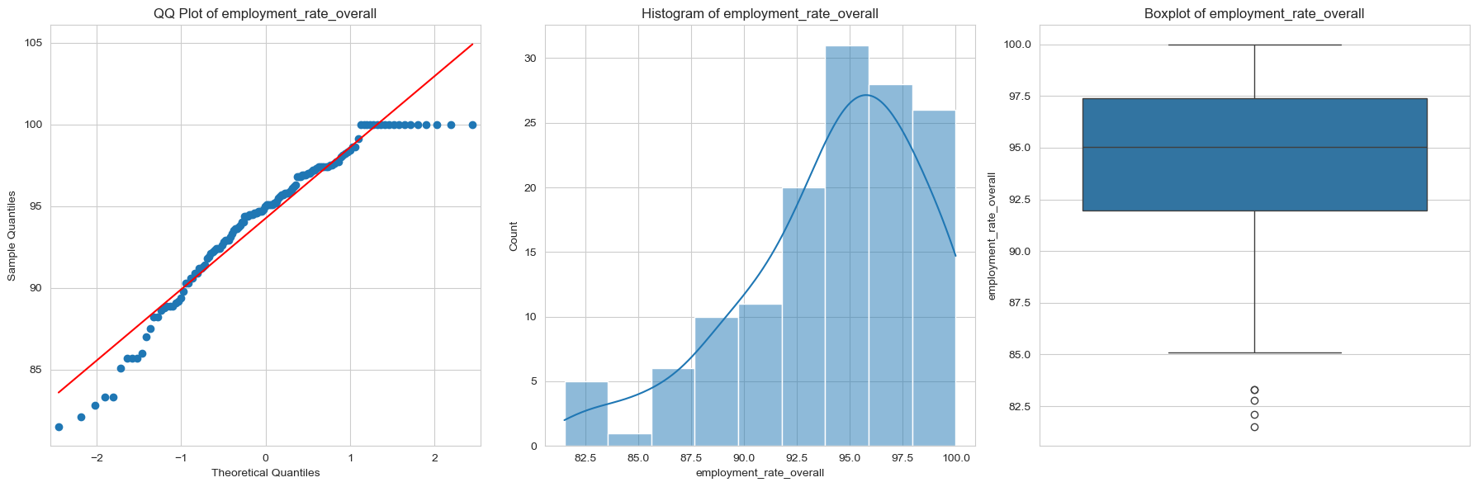
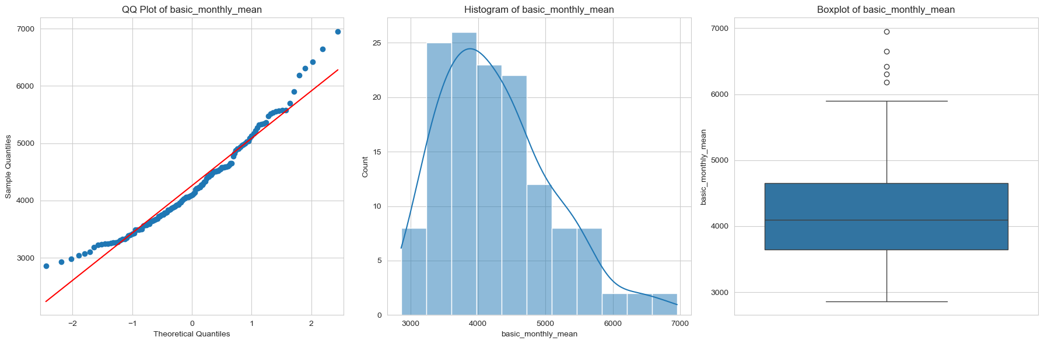
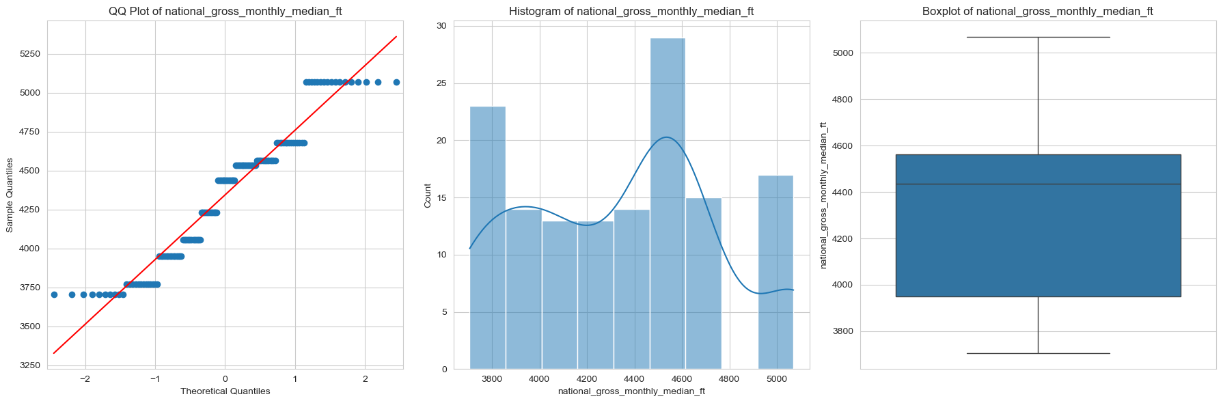
Data Distribution Analysis: Merged Dataset
Summary of QQ Plot Trends
Employment Rate (Overall)
Mostly normal distribution with slight skew and minor outliers, indicating stable employment trends with occasional dips.
Employment Rate (Full-Time Permanent)
Similar to overall employment, showing strong stability but with occasional lower outliers during economic downturns.
Basic Monthly Mean Salary
Right-skewed distribution, showing that while most salaries cluster around the median, some graduates earn significantly higher wages.
Basic Monthly Median Salary
Follows a similar pattern to the mean, reinforcing the presence of a wage gap due to higher-earning outliers.
Gross Monthly Mean Salary
Right-skewed, indicating that salaries are not evenly distributed and influenced by external economic factors.
Gross Monthly Median Salary
Follows a similar trend, confirming that salary distribution has a strong upward skew.
Gross Monthly 25th Percentile
Displays a lower bound for earnings, showing that some graduates earn significantly less than the median.
Gross Monthly 75th Percentile
Highlights the upper wage distribution, indicating that a subset of graduates consistently earns well above the average.
National Gross Monthly Median Income
Shows steady growth over time, reinforcing that national income plays a significant role in shaping salary trends for computing graduates.

Slide 15
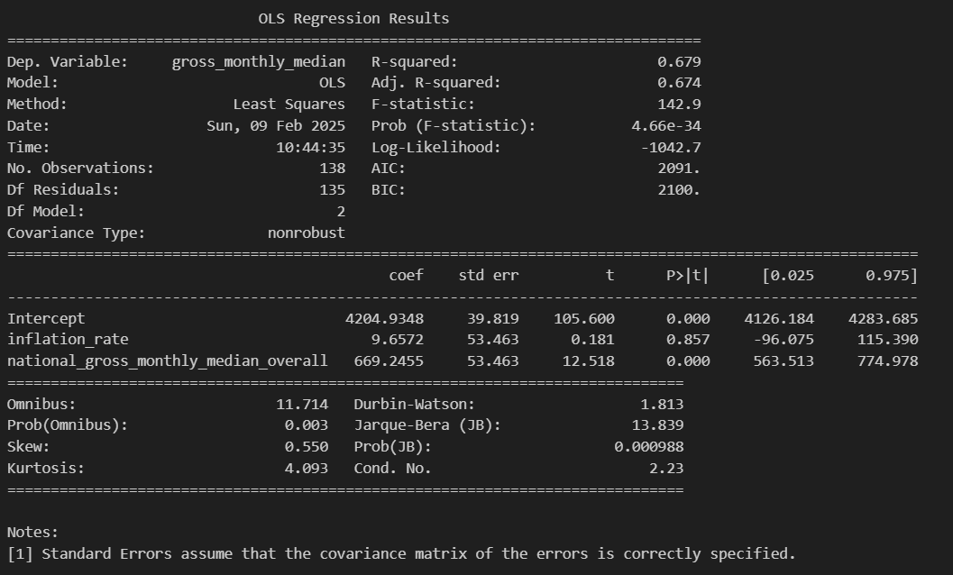



Predicting 2023 Employment Rate & Salary: Impact of Inflation & National Income on Computing Graduates (StatsModels)
gross_monthly_median ~ inflation_rate + national_gross_monthly_median overall
employment_rate_overall ~ inflation_rate + national_gross_monthly_median overall
The model explains 67.9% of the variance in computing graduates' salaries.
This suggests a strong relationship between the predictors (inflation and national income) and graduate salaries.
Impact of Inflation Rate (9.6572, p = 0.857)
Inflation has a very small and statistically insignificant impact on salaries.
Interpretation: A 1% increase in inflation is associated with only a $9.66 increase in salary, which is negligible.
Impact of National Gross Monthly Income (669.2455, p < 0.001)
National income has a very strong and statistically significant positive impact on computing graduates' salaries.
Interpretation: A $1,000 increase in the national gross median salary corresponds to a $669.25 increase in computing graduates' salaries.
The model explains 7.7% of the variance in employment rates, suggesting that other factors not included in this model also significantly influence employment rates.
While this is a relatively low R², it still provides useful insights.
Impact of Inflation Rate (-1.0956, p = 0.025)
Inflation has a negative and statistically significant effect on employment rates.
Interpretation: A 1% increase in inflation is associated with a 1.1% decrease in employment rates, holding all else constant.
Impact of National Gross Monthly Income (1.6214, p = 0.001)
National income has a positive and statistically significant effect on employment rates.
Interpretation: A $1,000 increase in the national gross median monthly salary correlates with a 1.62% increase in employment rates.

Slide 16


Data Visualisation With MatPlotLib & seaborn
Let’s Visualise Our Findings To Answer Our Research Question!

Slide 17




Data Visualisation: Pie Chart & Bar Chart
Code to plot out the Pie Chart!
Pie Chart Of University Distribution Of Computing Graduates
National University of Singapore (NUS) dominates – With 30.4% of computing graduates, NUS contributes the highest number of graduates in computing fields.
Singapore Institute of Technology (SIT) is the second-largest contributor – 26.8% of computing graduates come from SIT, making it another significant institution for computing education.
Nanyang Technological University (NTU) follows closely – With 22.5%, NTU plays an essential role in producing computing graduates.
Singapore Management University (SMU) has a moderate contribution – 14.5% of graduates come from SMU, suggesting a smaller computing program than the top three universities.
Singapore University of Technology and Design (SUTD) has the smallest share – At 5.8%, SUTD produces the least computing graduates, likely due to its focus on a more specialized curriculum.
Bar Chart Of Impact Of Inflation Rate On Gross Monthly Median Salary
NUS leads with 30.4% of computing graduates, followed by SIT (26.8%) and NTU (22.5%), showing the key institutions shaping the workforce.
SMU (14.5%) and SUTD (5.8%) contribute smaller shares, likely due to programme focus.
How This Answers Our Research Question
Understanding graduate distribution helps analyse how employment rates and salaries vary across institutions.
Links inflation and national income to university-level employment trends, showing how economic factors affect graduate salaries and job prospects.

Slide 18


Data Visualisation: Line Charts (Trends & Correlations)
Line Chart For National Gross Monthly Income VS Gross Monthly Median Over The Years
Key Observations from the Plot & Insights
Graduate salaries closely follow national income trends, showing a strong correlation.
Inflation has some impact on salaries but does not significantly affect employment rates.
Employment rates remain stable, indicating steady demand for computing graduates.
Higher national income leads to increased graduate salaries, linking economic growth to better wages.
How This Helps With Our Research Question
Shows how national income growth drives higher computing graduate salaries.
Confirms that employment rates are resilient despite inflation fluctuations.
Highlights the strong job prospects for computing graduates, even during economic changes.
Line Chart For Impact Of Inflations And National Gross Monthly On Computing Graduates' Salaries And Employment Rate
Key Observations from the Plot & Insights
Graduate salaries increase with national median income, showing a clear upward trend.
Employment rates remain consistently high (above 90%), despite economic changes.
Inflation affects salary growth, with higher inflation years linked to steeper salary increases.
How This Helps
Confirms that rising national income leads to higher computing graduate salaries.
Employment rates are stable, proving strong job security for computing graduates.
Inflation impacts salary growth, showing its role in wage adjustments.

Slide 19




Data Visualisation: Boxplot, Bar Chart, Histogram
Radar Plot
Key Insights
Computing salaries and national income have grown significantly over time.
Employment rates remain consistently high, showing strong job demand.
Inflation fluctuates, impacting salary growth but not job stability.
How This Supports Our Research Question
Confirms the link between rising national income and higher graduate salaries.
Demonstrates employment stability despite inflation changes.
Highlights inflation’s role in influencing salary trends over the years.
Correlation Matrix
National Income Drives Salary Growth!
Insight: Strong correlation (0.824) shows salaries rise with national income.
Impact: National income growth influences salary progression more than inflation.
Inflation Affects Salaries but Not Employment
Insight: Moderate correlation (0.554) with salaries, negligible impact (-0.004) on employment.
Impact: Inflation adjusts wages but does not affect job availability in computing
Employment Rates Remain Stable Despite Salary Changes
Insight: Weak correlation (0.362) between salaries and employment rates.
Impact: Computing graduates maintain high employment regardless of salary trends
Inflation and National Income Are Linked
Insight: Inflation correlates (0.664) with national income but at varying rates.
Impact: Inflation influences wage adjustments, but national income drives sustained salary growth.

Slide 20


Conclusions To Research Question
The truth awaits… Conclusions to our research question!

Slide 21
Steps Taken to Answer the Research Question
Data Collection & Cleaning (Pandas)
Gathered datasets from MOM (national income), World Bank (inflation rates), and Graduate Employment Survey (employment rates & salaries).
Merged datasets to create a unified table for analysis.
Removed duplicate rows (3,678 identified) and cleaned placeholder values to maintain data integrity.
Renamed columns for clarity and consistency across datasets.
2. Handling Missing & Invalid Data (Pandas & NumPy)
Identified missing values in key columns such as employment rate, salaries, and inflation rates.
Checked for invalid placeholder entries (university, school, degree) that do not provide real data. (Investigation Of Missing Year)
Used NumPy mean/median imputation for missing salary & employment data while ensuring statistical accuracy.
Dropped rows that contained entirely unusable data to prevent analysis bias!
5. Insights & Conclusion (MatPlotLib & seaborn)
Found that national income strongly correlates with computing graduate salaries, proving that economic growth boosts wages.
Employment rates remain stable over the years, showing strong demand for computing graduates, despite inflation fluctuations.
Inflation impacts salary adjustments but does not significantly affect job availability in computing fields.
Concluded that national economic trends drive salary growth, but employment rates are less dependent on inflationary pressures.
3. Exploratory Data Analysis (EDA)
Visualised employment & salary trends (2013–2023) using line graphs, bar charts, and scatter plots.
Created correlation heatmaps to measure relationships between employment, salary, inflation, and national income.
Used radar charts to compare economic trends affecting computing graduates.
Identified patterns in employment stability and salary growth over time.
4. Statistical & Regression Analysis (StatsModels)
Applied NumPy correlation analysis to measure the impact of inflation and national income on salaries and employment rates.
Performed Ordinary Least Squares (OLS) regression to quantify relationships between inflation, national gross income, and graduate salaries.
Assessed the strength and significance of these economic factors on employment outcomes.
Compared computed predictions with actual salary/employment trends in 2023.

Slide 22
Final Conclusions
National Income Growth Drives Salaries More Than Inflation
Graduate salaries rise more significantly when national gross monthly income increases.
Inflation impacts wages, but salary growth often lags, making it a weaker factor.
Economic cycles and wage policies influence earnings more than inflation alone.
→ Conclusion: While inflation affects wages, national income growth is the key driver of salary progression for computing graduates.
Employment Rates Remain High Despite Economic Fluctuations
Computing graduates consistently maintain high employment rates (>90%), even in downturns.
The tech industry remains resilient, offering strong job security despite inflation or crises.
Events like COVID-19 and the 2013 downturn slowed salary growth but did not significantly affect job availability.
→ Conclusion: The computing sector provides stable job opportunities, proving its resilience against economic uncertainties.
External Events (COVID-19 & Economic Downturns) Impacted Salary Growth (BONUS Finding!)
In 2013, weaker economic conditions led to lower graduate salaries.
COVID-19 (2020-2022) saw salary stagnation as companies froze wages despite rising inflation.
Post-pandemic recovery (2023) triggered a sharp salary increase, proving economic recovery fuels wage growth.
→ Conclusion: Salary growth is more affected by economic disruptions than inflation alone, highlighting the importance of economic recovery.
Overall Conclusion:
While inflation influenced salary adjustments, it had minimal direct impact on employment rates. The consistent growth of national income and demand for computing professionals played a more dominant role in shaping both salaries and job opportunities. This resilience underscores the stability of the tech industry in Singapore, where computing graduates continue to secure employment and experience steady income growth despite economic fluctuations.

Slide 23
Responsibilities & Tasks Completed!
Balamurugan Siddhartha (P2404312) | Lo Jia Wei (P2400277)
Exploratory Data Analysis Using NumPy & Pandas | StatsModels To Predict And Check Correlation
StatsModels Model 1 & 2 (To Predict & Check Correlation) | Exploratory Data Analysis Using NumPy & Pandas
Notebook Quality & Structure, Added Markdowns & Comments! | Converting Codes Into Modular Functions & Markdown.
Completed PPT Slides Formatting & Content Structure | Completed PPT Slides Formatting & Content Structure
Collaborated On Teams Frequently To Discuss On Workflow & Research Question! | Collaborated On Teams Frequently To Discuss On Workflow & Research Question!

Slide 24
Thank You!
End Of CA2 Assignment : Done by Balamurugan Siddhartha (P2404312) , Lo Jia Wei (P2400277)

